Slide 1
Watumull Institute Of Electronics Engineering And Computer Technology
Music Recommendation System
By group 10
Tanmay Kulkarni(25)
Pushpak Maind(28)
Rahul Patil(37)
Vishal Shirke(48)
Project guide:
Prof. Naveen Vaswani

Slide 2


Introduction
Nowadays lot of music industries like amazon music, spotify, gaana.com are using recommender systems and the old fashioned way of selling music has changed to a totally different cloud based. But the issue is there are lot of songs to choose from, so we need to classify all the songs and the main goal is to classify these set of songs in accordance to the taste of the user.
Moreover, music service providers need an efficient way to manage songs and help their customers to discover music by giving quality recommendation. Thus, there is a strong need of a good music recommendation system.

Slide 3
Problem Statement
There are too much songs to choose from.
Most of the systems give recommendations on the same genre or artist.
This lack of variety results in limiting a user to a few selective songs.
Even if listening to music is his/her best hobby. People sometimes feel difficult to choose from millions of songs.
The solution is to use a recommender system which learns from users listening history and features of songs and predicts what users would like to listen.

Slide 4
Proposed System
A music recommendation system which is better and easy to use.
The system will predict songs based on users behavior.
The system will take a song as an input and recommend no. of songs based on users request.
The goal of this recommendation system would be to provide personalized content by rightly identifying what the user wants and save their time.
To achieve this we will use machine learning techniques to make a recommendation model.
This model will be able to suggest songs based on users choices.

Slide 5
Recommendation system
A recommender system, or a recommendation system is a subclass of information filtering system that seeks to predict the "rating" or "preference" a user would give to an item.
Recommender systems usually make use of either or both collaborative filtering and content-based filtering (also known as the personality-based approach)
Recommendation System
Collaborative Filtering
Content-based approach
Hybrid Models

Slide 6
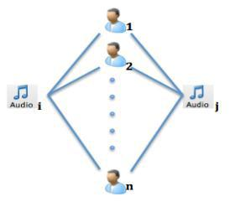
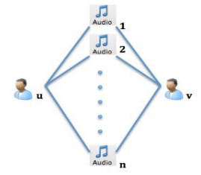
Collaborative Filtering
Collaborative filtering is a method of making predictions (filtering) about the interests of a user by collecting preferences or taste information from many users (collaborating).
Item-Based
User-Based

Slide 7
Project Workflow
Data Cleaning
Text Data
Model Architecture
Website
EDA
Data Training
Collaborative Filtering
Recommendation
Data Preprocessing
User Input

Slide 8
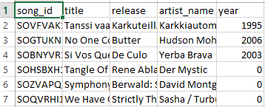
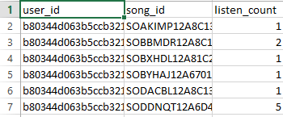
Dataset Info
Features:
Large Scale : 1 million users
½ million songs
Content:
Song Data: (song id, title, release, artist name, year)
Triplet: (user id, song id, listen count)

Slide 9
Hardware Requirements:
Computer/laptop
Intel i3 6th Gen or higher/4gb Ram
Software Requirements:
Python
HTML, CSS
Numpy
Pandas
Jupyter Notebook

Slide 10
References
https://cse.iitk.ac.in/users/cs365/2014/_submissions/shefalig/project/:Music Recommendation System by IIT Kanpur
A Survey of Music Recommendation Systems and Future Perspectives Yading Song, Simon Dixon, and Marcus Pearce.
McFee, B., BertinMahieux,T., Ellis, D. P., Lanck-riet, G. R. (2012, April). The million song dataset challenge. In Proceedings of the 21st international conference companion on World Wide Web (pp. 909916).ACM
https://www.ijert.org/music-recommendation-system: Smt. Namitha S J 1 Assistant Professor, Department of Computer Science & Engineering, B N M Institute of Technology, Bangalore, India 1.
Analysis of Music Recommendation System using Machine Learning Algorithms Prachi Singh1, Mr. Pankaj K. Singh2, Mr. Amit Ganguli3, Mr. Ajit Shrivastava4. International Research Journal of Engineering and Technology (IRJET)
https://labrosa.ee.columbia.edu/millionsong/: Million Song Dataset | scaling MIR research.[online]

Slide 11
!!!Thank You!!!

